Slide 1


SRI KRISHNA COLLEGE OF ENGINEERING AND TECHNOLOGY (AN AUTONOMOUS INSTITUTION, AFFILIATED TO ANNA UNIVERSITY, ACCREDITED BY NAAC WITH ‘A’ GRADE) ACCREDITED BY NBA (CSE, IT, ECE, EEE, MECH, MCT & CIVIL)
SKCET CLASS LECTURE
SUBJECT | : | 23AS101 - APPLIED SCIENCE
 |  | (Common to B.E. CSD, CSE, CSE (CYBER SECURITY), ECE, EEE, MCT & B.Tech. AI&DS, IT)
MODULE | : | ELECTROCHEMISTRY
TOPIC | : | ELECTROCHEMISTRY
FACULTY | : | Dr. M. JEYARAJ
www.skcet.ac.in

Slide 2

Description
Electrochemical cells-electrolytic cell-reversible and irreversible cells
Free energy and emf, cell potentials
Nernst equation and applications. Oxidation and reduction potentials
Standard hydrogen electrode, saturated calomel electrode,
Glass electrode-pH measurement

Slide 3
Introduction
Electrochemistry is a branch of chemistry, which deals with the chemical applications of electricity. Electrochemistry deals with the chemical reactions produced by passing electric current through an electrolyte or the production of electric current through chemical reactions.

Slide 4
Conductors
A substance or material that allows electric current to pass through it is called a conductor. The ability of a material to conduct electric current is called conductance.
All metals, graphite, fused salts, aqueous solutions of acids, bases, etc.,
Non-Conductors (or) Insulators
Materials which do not conduct electric current are called non-conductors or insulators.
Plastics, wood, most of the non metals, etc.,

Slide 5
Types of Conductors
The conductors are broadly classified into two types
1. Metallic conductors (or) Electronic conductors
Metallic conductors are solid substances, which conduct electric current due to the movement of electrons from one end to another end. The conduction decreases with increase of temperature.
All metals, graphite.
2. Electrolytic Conductors
Electrolytic conductors conduct electric current due to the movement of ions in solution or in fused state. The conduction increases with increase of temperature.
Acids, bases, electrovalent substances.

Slide 6
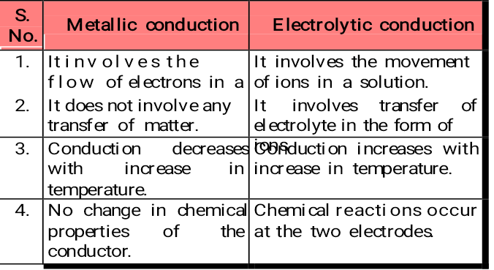

Slide 7
Oxidation and Reduction potential
The tendency of an electrode to lose electrons is called the oxidation potential, and the tendency of an electrode to gain electrons is called the reduction potential.
Factors affecting electrode potential
The rate of the above reactions depend on
The nature of the metal.
The temperature.
The concentration of metal ions in solution.

Slide 8
Single electrode potential (E)
It is the measure of tendency of a metallic electrode to lose or gain electrons, when it is in contact with a solution of its own salt.
Standard electrode potential (E°)
It is the measure of tendency of a metallic electrode to lose or gain electrons, when it is in contact with a solution
of its own salt of 1 molar concentration at 25°C.
Notes:
8

Slide 9
Nernst equation for electrode potential
Consider the following redox reaction
M^{n+} + ne− −−−−−> M
For such a redox reversible reaction, the free energy change (∆G) and its equilibrium constant (K) are inter related as
∆G = − RT ln K + RT ln [ Product ]
[ Reactant]
= ∆G° + RT ln [ Product ] ........ (1)
[ Reactant ]
where, ∆G° = Standard free energy change

Slide 10
The above equation (1) is known as Van’t Hoff isotherm. The decrease in free energy (− ∆G) in the above reaction involves transfer of ‘n’ number of electrons, then ‘n’ faraday of electricity will flow. If E is the emf of the cell, then the total electrical energy (nEF) produced in the cell is
− ∆G = nEF
(or)
− ∆G° = nE°F ........ (2)
where,
− ∆G = decrease in free energy change.

Slide 11
(or) − ∆G° = decrease in standard free energy change. Comparing equation 1 and 2, it becomes
− nEF = − nE°F + RT ln [ M ]
[ M^{n+}] . .......(3)
Dividing the above equation (3) by − nF
[ the activity of solid metal [M] = 1 ]
E = E° − RT ln 1
nF [ M^{n+} ]
In general, E = E° − RT ln [Product]
nF [Reactant]
(or)
E = E° + RT ln [ M^{n+} ]
nF

Slide 12
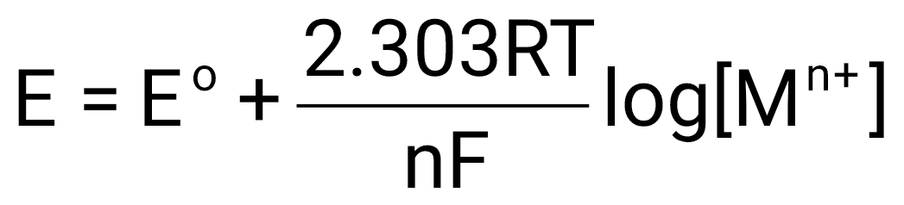
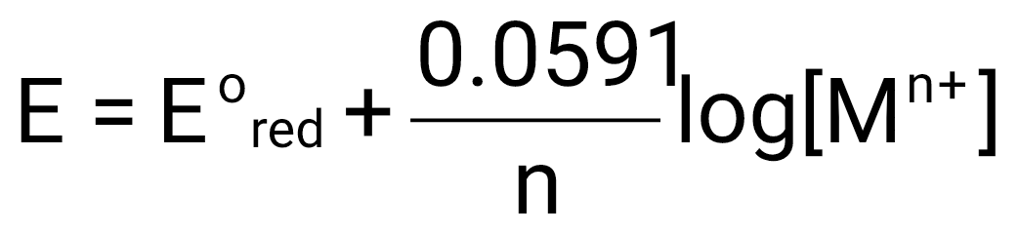
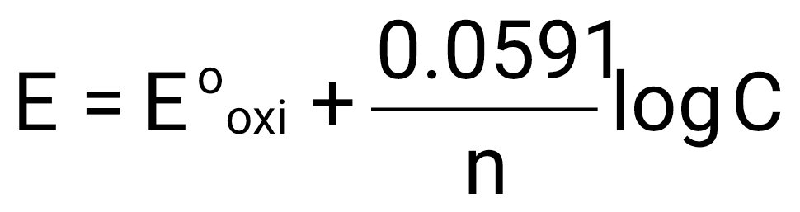
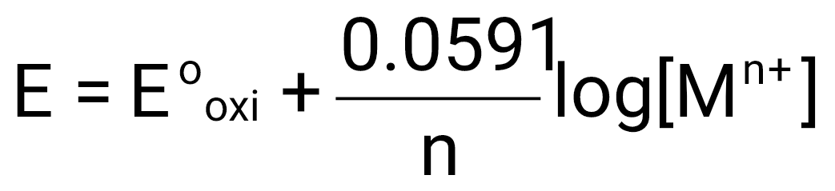
When, R = 8.314 J/K/mole; F = 96500 coulombs ;
T = 298 K (25°C), the above equation becomes
In general,
Similarly for oxidation potential
“Nernst equation for single electrode potential”.

Slide 13
Applications of Nernst equations
Nernst equation is used to calculate electrode potential of unknown metal.
Corrosion tendency of metals can be predicted.

Slide 14
REFERENCE ELECTRODES (STANDARD ELECTRODES)
The electrode potential is found out by coupling the electrode with another reference electrode, the potential of which is known or arbitrarily fixed as zero. The important primary reference electrode used is a standard hydrogen electrode, standard electrode potential of which is taken as zero.
It is very difficult to set up a hydrogen electrode. So other electrodes called secondary reference electrodes like calomel electrodes are used.

Slide 15
Primary Reference Electrode (Standard Hydrogen electrode)
Construction
Hydrogen electrode consists of platinum foil, that is connected to a platinum wire and sealed in a glass tube. Hydrogen gas is passed through the side arm of the glass tube. This electrode, when dipped in a 1M HCl and hydrogen gas at 1 atmospheric pressure is passed forms a standard hydrogen electrode. The electrode potential of SHE is zero at all temperatures. (Fig. 1.2).

Slide 16
It is represented as,
Pt , H₂ (1 atm)/H⁺ (1 M); E° = 0 V
In a cell, when this electrode acts as anode, the electrode reaction can be written as
H₂ (g) −−−−−> 2H⁺ + 2e⁻
When this electrode acts as cathode, the electrode reaction can be written as
2H⁺+2e⁻ −−−−−> H2(g)

Slide 17

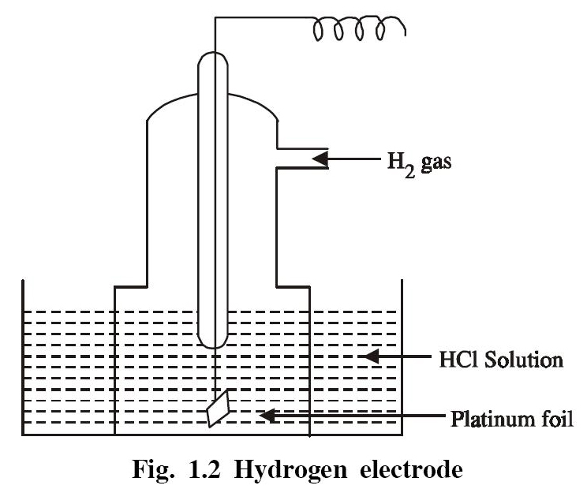
Limitations
It requires hydrogen gas and is difficult to set up and transport.
It requires considerable volume of test solution.
The solution may poison the surface of the platinum electrode.
The potential of the electrode is altered by changes in barometric pressure.

Slide 18
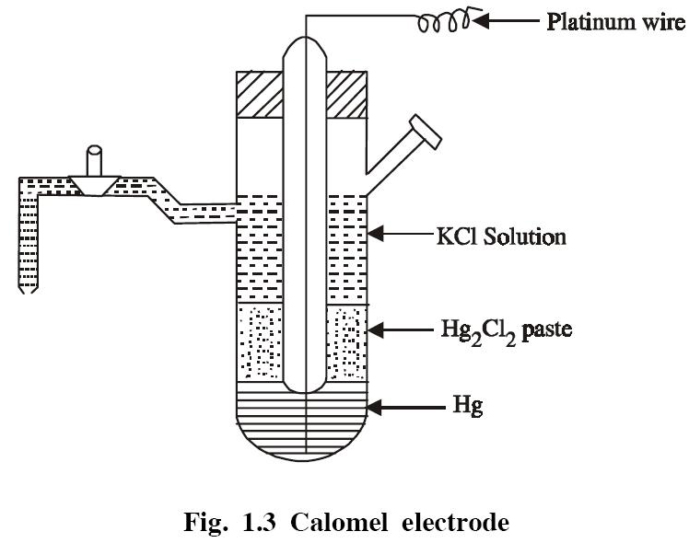
Secondary Reference Electrode (Saturated Calomel Electrode)

Slide 19
Construction
Calomel electrode consists of a glass tube containing mercury at the bottom over which mercurous chloride is placed. The remaining portion of the tube is filled with a saturated solution of KCl. The bottom of the tube is sealed with a platinum wire (Fig. 1.3). The side tube is used for making electrical contact with a salt bridge. The electrode potential of the calomel electrode is + 0.2422 V.
It is represented as,
Hg , Hg₂Cl₂ (s) , KCl (sat.solution); E° = 0.2422 V

Slide 20
If the electrode acts as anode the reaction is
2Hg_{(l)} −−−−−> Hg₂²⁺ + 2e⁻
Hg₂²⁺ + 2Cl⁻−−−−−>Hg₂Cl₂ _{(s)}
2Hg_{(l)} + 2Cl⁻ Hg₂Cl₂ _{(s)} + 2e⁻
If the electrode acts as cathode the reaction is
Hg₂ Cl₂ (s) −−−−−>Hg₂²⁺ + 2Cl⁻
Hg₂²⁺ + 2e⁻−−−−−> 2Hg_{(l)}
Hg₂Cl₂ _{(s)} + 2e⁻ 2Hg_{(l)} + 2Cl^{−`}

Slide 21
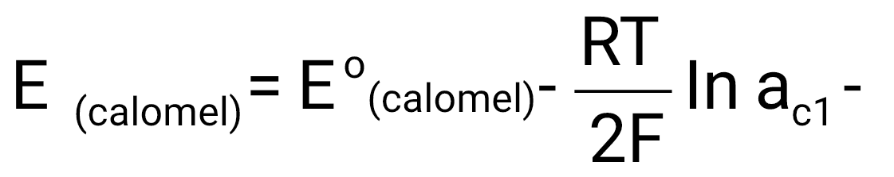
The electrode potential is given by (for example cathode)
The electrode potential depends on the activity of the chloride ions and it decreases as the activity of the chloride ions increases. The single electrode potential of the three calomel electrodes on the hydrogen scale at 298 K are given as
0.1 N KCl = + 0.3338 V
1.0 N KCl = + 0.2800 V
Saturated KCl = + 0.2422 V.

Slide 22
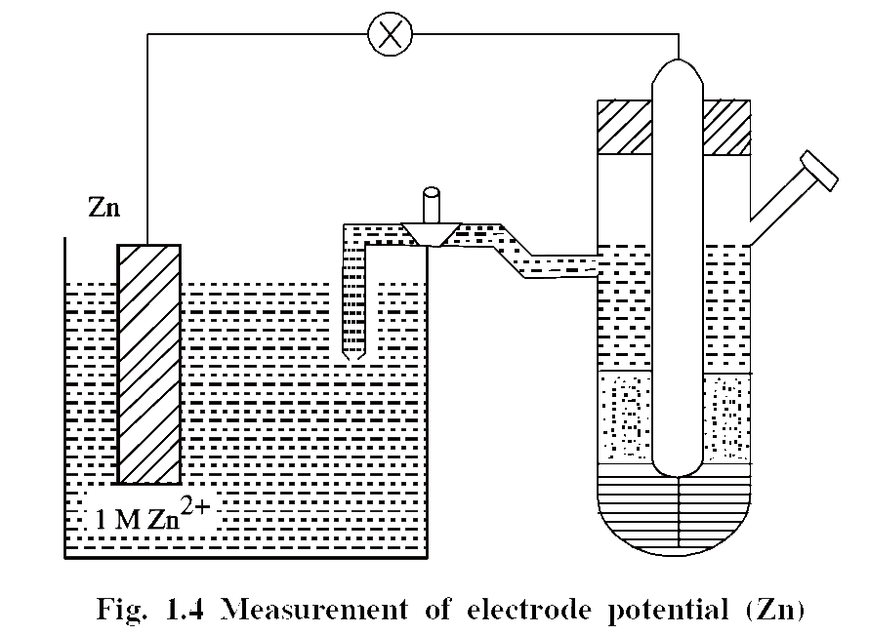
Measurement of single electrode potential of
Zn using saturated calomel electrode
The saturated calomel electrode is coupled with another Zn electrode, the potential of which is to be determined (Fig. 1.4). Since the reduction potential of the coupled Zn electrode is less than E° of calomel electrode (+ 0.2422 V), the calomel electrode will act as cathode and the reaction is

Slide 23
At Anode:
Zn Zn²⁺ + 2e− (Oxidation)
At Cathode:
Hg₂Cl₂ _{(s)} + 2e− 2Hg_{(l)} + 2Cl⁻ (Reduction)
Zn + Hg₂Cl₂ _{(s)} ZnCl₂ + 2Hg _{(l)}
E_{cell} = E°_{right} − E°_{left}
E_{cell} = E°_{cal} − E°_{Zn}
E°_{Zn} = E°_{cal} − E_{cell}
= + 0.2422 − 1.0025
E°_{Zn} = − 0.7603 volt .

Slide 24

Ion-Selective Electrodes (ISE)
Ion-selective electrodes are the electrodes having the ability to respond only to a particular ions, and develop potential, ignoring the other ions in a mixture totally. The potential developed by an ion-selective electrode depends only on the concentration of particular ions.
Glass Electrode
The glass membrane of the glass electrode is only selective to H⁺ ions only in a mixture.

Slide 25
Glass Electrode (Internal Reference Electrode)
Construction
A glass electrode consists of thin-walled glass bulb (the glass is a special type having low melting point and high electrical conductivity) containing a Pt wire in 0.1M HCl (Fig.1.5). The glass electrode is represented as
Pt, 0.1 M HCl / Glass
HCl in the bulb furnishes a constant H⁺ ion concentration.

Slide 26
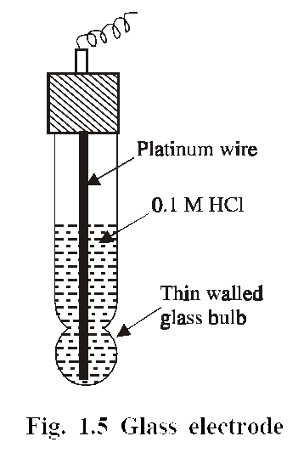

Slide 27
Glass electrode is used as the “internal reference electrode”. The pH of the solutions, especially coloured solutions containing oxidizing or reducing agents can be determined. The thin walled glass bulb called glass membrane functions as an ion-exchange resin, and an equilibrium is set up between the Na⁺ ions of glass and H⁺ ions in solution. The potential difference varies with the H⁺ ion concentration, and its emf is given by the expression
E_{G} = E°_{G} + 0.0592 pH

Slide 28
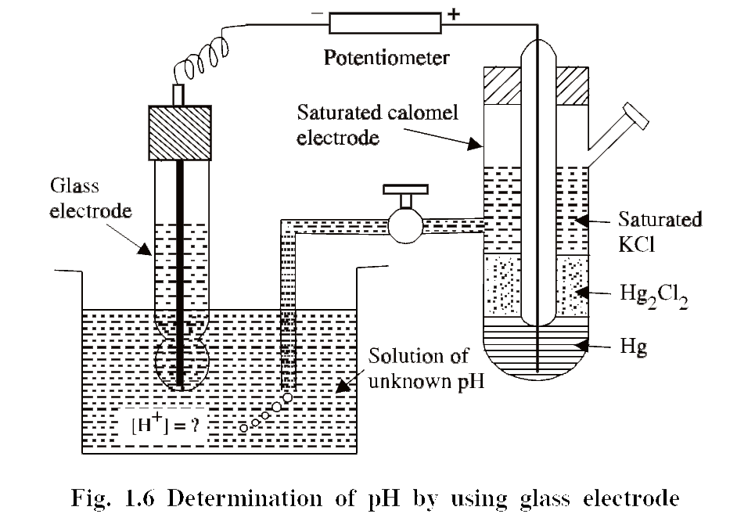
Determination of pH of a Solution using Glass Electrode
The glass electrode is placed in the solution under test and is coupled with saturated calomel electrode as shown in the figure 1.6.

Slide 29
The emf of the cell is measured. From the emf, the pH of the solution is calculated as follows
E_{cell} = E_{right} − E_{left}
E_{cell} = E_{cal} − E_{G}
E_{cell} = E_{cal} − (E°_{G} + 0.0592 pH)
E_{cell} = E_{cal} − E°_{G} − 0.0592 pH
pH = E_{cal} − E°_{G} − E_{cell} ∴ E_{cal} = 0.2422 V
0.0592
∴ pH = 0.2422 – Eº_{G} – E_{cell}
0.0592

Slide 30
Advantages of Glass Electrode
It can be easily constructed and readily used.
The results are accurate.
It is not easily poisoned.
Equilibrium is rapidly achieved.
Disadvantages (Limitations)
Since the resistance is quite high, special electronic potentiometers are employed for measurement.
The glass electrode can be used in solutions only with pH range of 0 to 10. However above the pH 12 (high alkalinity), cations of the solution affect the glass and make the electrode useless.

Slide 31
Applications of ISEs
(i) ISEs are used in determining the concentrations of cations like H⁺, Na⁺, K⁺, Ag⁺, Li⁺.
(ii) ISEs are used for the determination of hardness Ca²⁺ and Mg²⁺ ions).
(iii) Concentrations of anions like NO₃⁻, CN⁻, S²⁻, halides (X⁻) can be determined.
(iv) ISEs are used in the determination of concentration of a gas by using gas-sensing electrodes.
(v) pH of the solution can be measured by using glass electrode.

Slide 32
CELLS
A cell is a device consisting two half cell. Each half cell consists of an electrode dipped in an electrolytic solution. The two half cells are connected through one wire.
TYPES OF CELLS
1. Electrolytic cells.
2. Electrochemical cells (or)voltaic cells (or) galvanic cells.

Slide 33
ELECTROLYTIC CELLS
Electrolytic cells are cells in which electrical energy is used to bring about the chemical reaction.
Electrolysis, electroplating, etc.,
ELECTROCHEMICAL CELLS OR GALVANIC CELLS
Electrochemical cells are entirely different from electrolytic cells. The cells used for electrolysis (where electrical energy is converted to chemical energy) are called electrolytic cells, whereas in electrochemical cells, chemical energy is converted to electrical energy. Galvanic cells are electrochemical cells in which the electrons, transferred due to redox reaction, are converted to electrical energy.
Daniel cell
Notes:
33

Slide 34
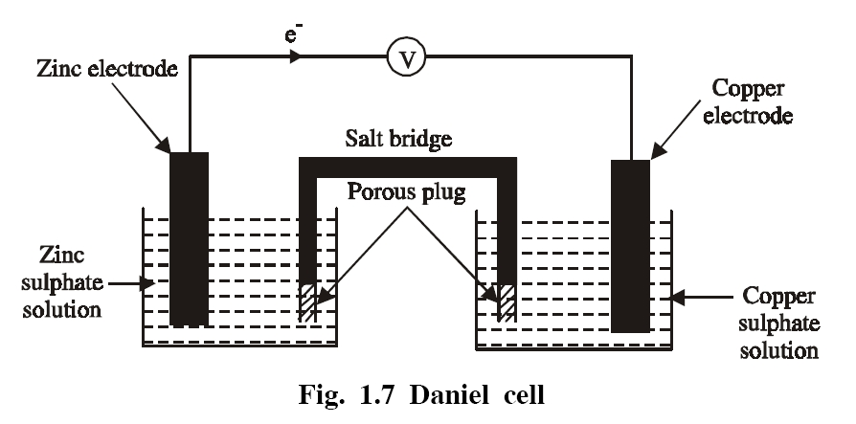
Cell device (Construction)
Daniel cell consists of a zinc electrode dipped in 1 M ZnSO₄ solution and a copper electrode dipped in 1 M CuSO₄ solution. Each electrode is known as a half cell. The two solutions are inter connected by a salt bridge and the two electrodes are connected by a wire through the voltmeter.

Slide 35
Reactions occurring in the cell
At anode: Oxidation takes place in the zinc electrode by the liberation of electrons, so this electrode is called negative electrode or anode.
At cathode: Reduction takes place in the copper electrode by the acceptance of electrons, so this electrode is called the positive electrode or cathode.
Zn −−−−−> Zn²⁺ + 2e⁻ (at anode)
Cu²⁺ + 2e⁻ −−−−−> Cu (at cathode)
Cu²⁺ + Zn −−−−−> Zn²⁺ + Cu (net cell reaction)
The electrons liberated by the oxidation reaction flow through the external wire and are consumed by the copper ions at the cathode.

Slide 36
Salt bridge
It consists of a U-tube containing saturated solution of KCl or NH₄NO₃ in agar-agar gel. It connects the two half cells of the galvanic cells.
Functions of salt bridge
It eliminates liquid junction potential.
It provides the electrical continuity between the two half cells.
Conditions for a cell to act as standard cell
The conditions for an electrochemical cell to act as a standard cell are
The e.m.f of the cell is reproductive.
The temperature-coefficient of emf should be very low.

Slide 37
Representation of a galvanic cell (or) Cell diagram
(i) A galvanic cell consists of two electrodes anode and cathode.
(ii) The anode is written on the left hand side while the cathode is written on the right hand side.
The anode must be written by writing electrode metal first and then electrolyte. These two are separated by a vertical line or a semicolon. The electrolyte may be written by the formula of the compound (or) by ionic species.
Zn / Zn²⁺ (or) Zn / ZnSO₄ (or) Zn; Zn²⁺

Slide 38
IV) The cathode must be written by writing electrolyte first and then the electrode metal. These two are separated by a vertical line or a semicolon.
Cu²⁺ / Cu (or) CuSO₄ / Cu (or) Cu²⁺; Cu
(v) The two half cells are separated by a salt bridge, which is indicated by two vertical lines.
Zn / ZnSO₄ (1 M) // CuSO₄ (1 M) / Cu (or)
Zn / Zn²⁺ (1 M) // Cu²⁺ (1 M) / Cu (or)
Zn ; Zn²⁺ (1 M) // Cu²⁺ (1 M) ; Cu

Slide 39
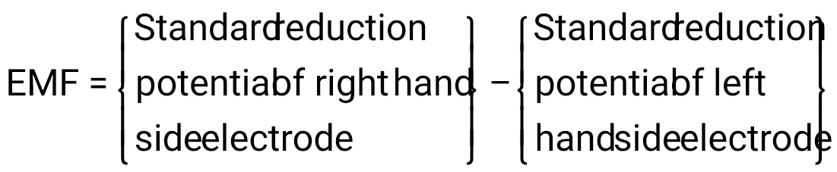
EMF OF A CELL:
Definition
Electromotive force is defined as, "the difference of potential which causes flow of current from one electrode of higher potential to the other electrode of lower potential.
Thus, the emf of a galvanic cell can be calculated using the following relationship.

Slide 40
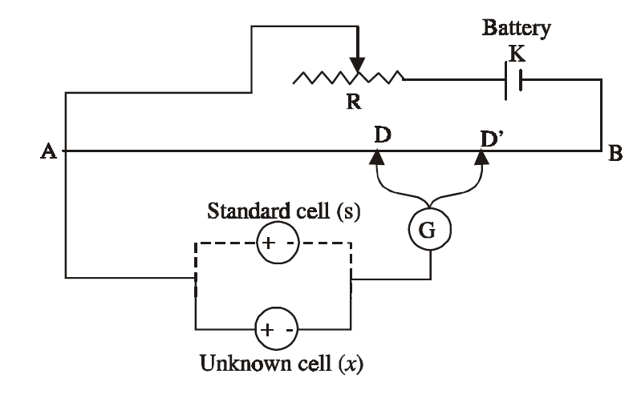
Measurement of emf of a cell:
The potential difference or emf of a cell can be measured on the basis of poggendorff’s compensation principle. Here the emf of the cell is just opposed or balanced by an emf of standard cell (external emf), so that no current flows in the circuit.

Slide 41
The potentiometer consists of a uniform wire AB . A storage battery (K) is connected to the ends A and B of the wire through a rheostat (R). The cell of unknown emf (x) is connected in the circuit by connecting its positive pole to A and the negative pole is connected to a sliding contact (D) through a galvanometer G. The sliding contact is freely moved along the wire AB till no current flows through the galvanometer. Then the distance AD is measured. The emf of unknown cell is directly proportional to the distance AD.
E_{x} ∝ AD

Slide 42
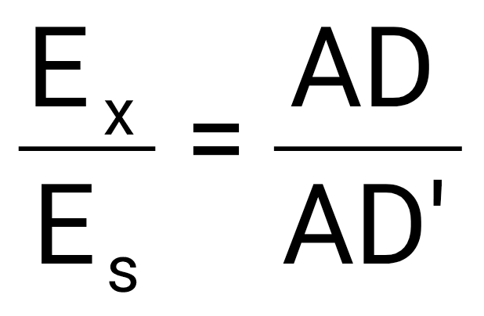
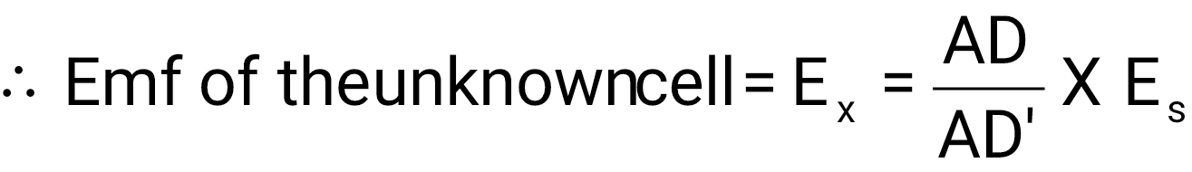
Then the unknown cell (x) is replaced by a standard cell (s) in the circuit. The sliding contact is again moved till there is null deflection in the galvanometer. Then the distance AD′ is measured. The emf of standard cell Es is directly proportional to the distance AD′. E_{s} ∝ AD′
The emf of the unknown cell can be calculated from the following equation.

Slide 43
Factors affecting emf of a cell
1. Nature of the electrolytes and electrodes.
2. Concentration and composition of the electrolytes.
3. pH and temperature of the solution.
Applications of emf measurements
Determination of standard free energy change and equilibrium constant.
Determination of pH by using a standard hydrogen electrode.
Solubility of a sparingly soluble salt can be determined.
Valence of an ion can be determined

Slide 44
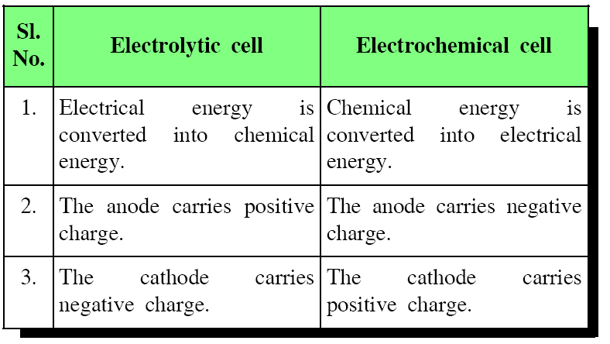
Differences between electrolytic cells and electrochemical cells

Slide 45
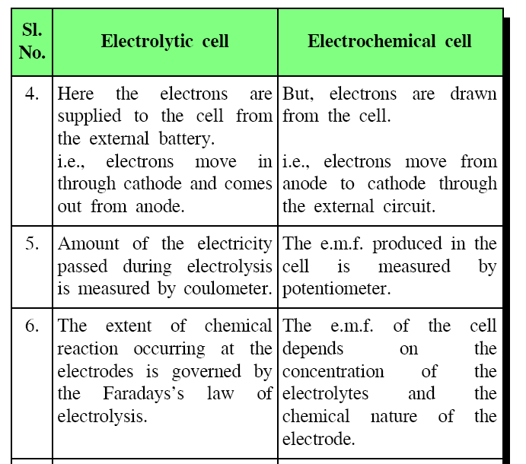

Slide 46
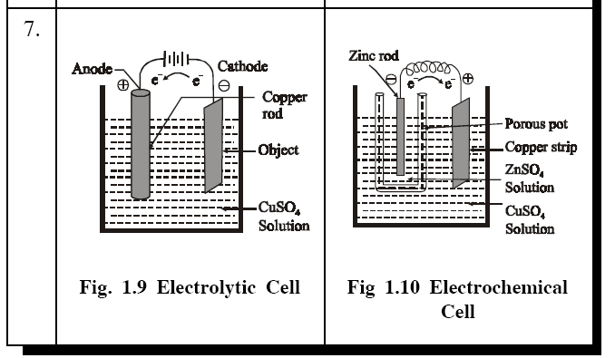

Slide 47
REVERSIBLE AND IRREVERSIBLE CELLS
Reversible Cells
Daniel cell, secondary batteries (rechargeable batteries).Daniel cell is a very good example for a reversible cell Its emf is 1.1 volt. It is represented as Zn/ZnSO4(1 M)//CuSO4 (1 M)/Cu
A cell which obey the following three conditions of thermodynamic reversibility is called reversible cell.
(i) If the Daniel cell is connected to an external source of emf equal to 1.1 volt, no current flows and also no chemical reaction takes place in the cell.
(ii) If the external emf is made slightly less than 1.1 volt, small amount of current flows from the cell and small chemical reaction occurs.

Slide 48
(iii) If the external emf is made slightly greater than 1.1 volt, the current will flow in the opposite direction. Copper will pass into the solution as copper ions and zinc will get deposited on the zinc electrode.
Irreversible Cells
Zinc – silver cell, Dry cell (Primary Cells)
Cells which do not obey the conditions of thermodynamic reversibility are called irreversible cells. Zinc-Silver cell is an example for a irreversible cell.
It is represented as
Zn/H2SO4(aq)/Ag
The cell reactions occur at anode and cathode are,
Zn + H2SO4 −−−> ZnSO4 + H2↑ (at anode)
2Ag⁺ + 2e⁻ −−−> 2Ag (at cathode)
Notes:
48

Slide 49
When the two electrodes are connected, zinc dissolves with the liberation of hydrogen gas.
When the external emf, slightly greater than the actual emf of the cell, is applied to it, the above reactions are not reversed.
Because one of the product, H2 gas, is already escaped. Such a cell, which does not obey the conditions of thermodynamic reversibility is called an irreversible cell.

Slide 50
Gibbs free energy:
The difference between the enthalpy of a system and the product of its entropy and absolute temperature; a measure of the useful work obtainable from a thermodynamic system at constant temperature and pressure.
In a galvanic cell, the Gibbs free energy is related to the potential by: ΔG°cell = −nFE°cell
If E°cell > 0, then the process is spontaneous (galvanic cell).
If E°cell < 0, then the process is nonspontaneous (electrolytic cell).

